Slide 1
The Endocrine System
& Hormone Physiology
SBI4U Biology

Slide 2
The Endocrine System
A system of glands connected only by blood vessels; a very dispersed system.
Endo = secreting within the body.
Each gland has specific target organs.

Slide 4
Hormones
Chemical messengers; released by a gland to create response in another organ
Two basic types:
  Peptide = protein-based
  Steroid = cholesterol-based
Each type has a slightly different mode of acting on their target cells.

Slide 5
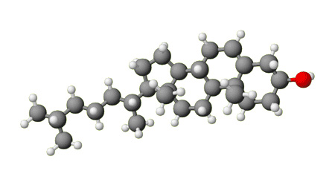
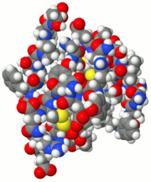
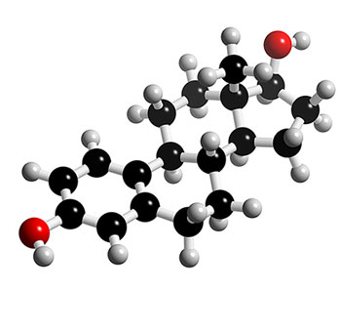
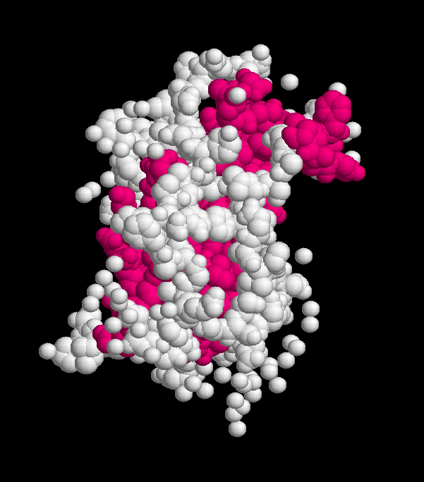
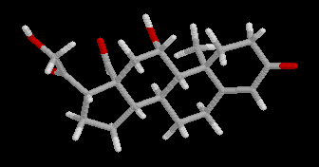
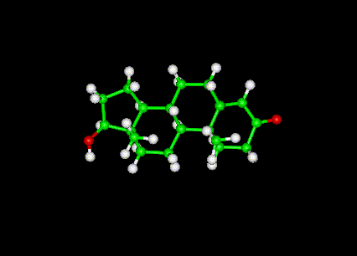
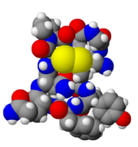
Steroids
Insulin
Cholesterol
Somatotropin Growth Hormone
Estrogen
Aldosterone
ADH
Peptides
Testosterone

Slide 6
Steroid Hormone Action
Mobile Receptor System
Steps:
  Hormone diffuses from cell into blood
  Diffuses into the cells of target tissue
  Attaches to receptor molecule in cytoplasm
  Hormone/Receptor (HR) Complex enters nucleus of target cell
  HR Complex activates transcription of a particular gene to induce hormone effect

Slide 7
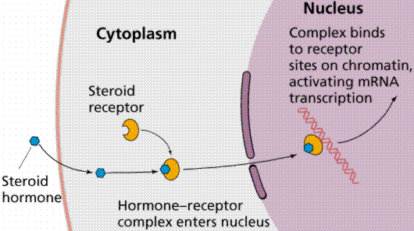

Slide 8
Peptide Hormone Action
Second Messenger System
Steps:
  Hormone diffuses from cell into blood
  Attaches to a receptor on the exterior cell membrane of target cells
  HR Complex triggers production of cAMP (Cyclic AMP)
  cAMP triggers a specific enzyme cascade to induce hormone effect

Slide 9
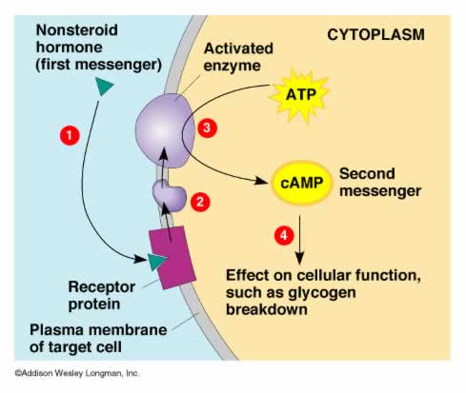

Slide 10
Hormone Hierarchy
Hierarchy = a system of rank, importance
Integration of Nervous & Endocrine systems
Levels of Control, from top down, are:
  Hypothalamic Releasing Hormones
  Anterior Pituitary Tropic Hormones
  Posterior Pituitary – ADH, Oxytocin.
  Remaining endocrine glands
  Target tissues (effectors of responses)

Slide 12
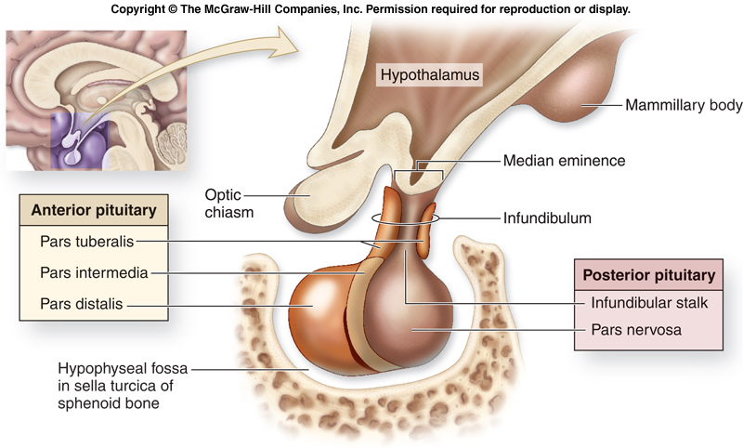

Slide 13
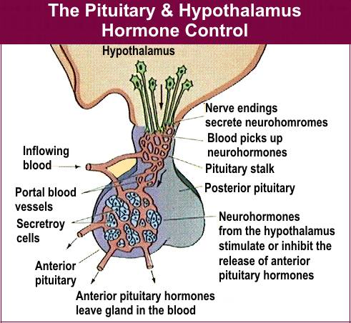

Slide 15
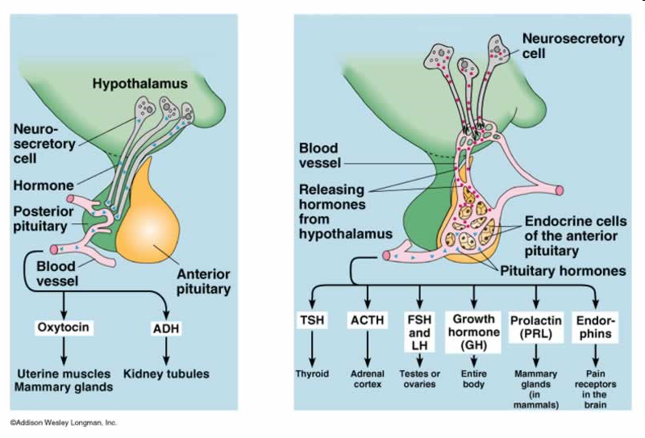

Slide 16
Hypo-
thalamus
ACRH
ACTH
Adrenal
Cortex
Adreno-
Corticoids
TRH
TSH
Thyroid
Thyroxine
Triiodiothyronine
GnRH
FSH
Testes
Ovaries
Testosterone
Estrogen
LH
Testes
Ovaries
Estrogen
Progesterone
PRH
Prolactin
Mammary
Glands
SRH
GH
Somatotropin
Liver, Bone
Muscle
PPRH
ADH
Nephrons
Blood Vessels
Oxytocin
Mamm. Glands
Uterus
Lactation
Mitosis, protein synthesis, metabolism
Fluid balance
Vaso-constriction
Lactation
Uterine contraction
Mineral balance, Gluconeo-genesis
Increased metabolism, heart rate, heat
Gametogenesis
Sexual maturity
Reproduction
Ovulation

