Slide 1
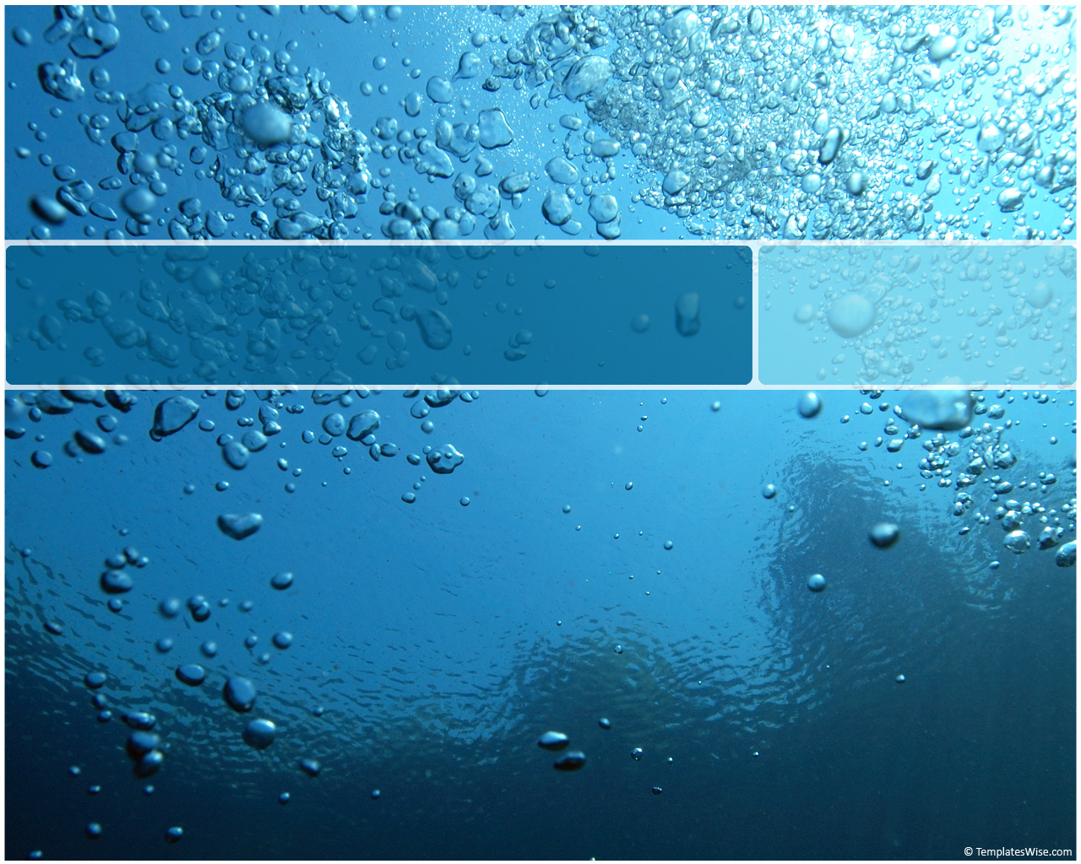
Fluid Balance
SBI4U Biology

Slide 2
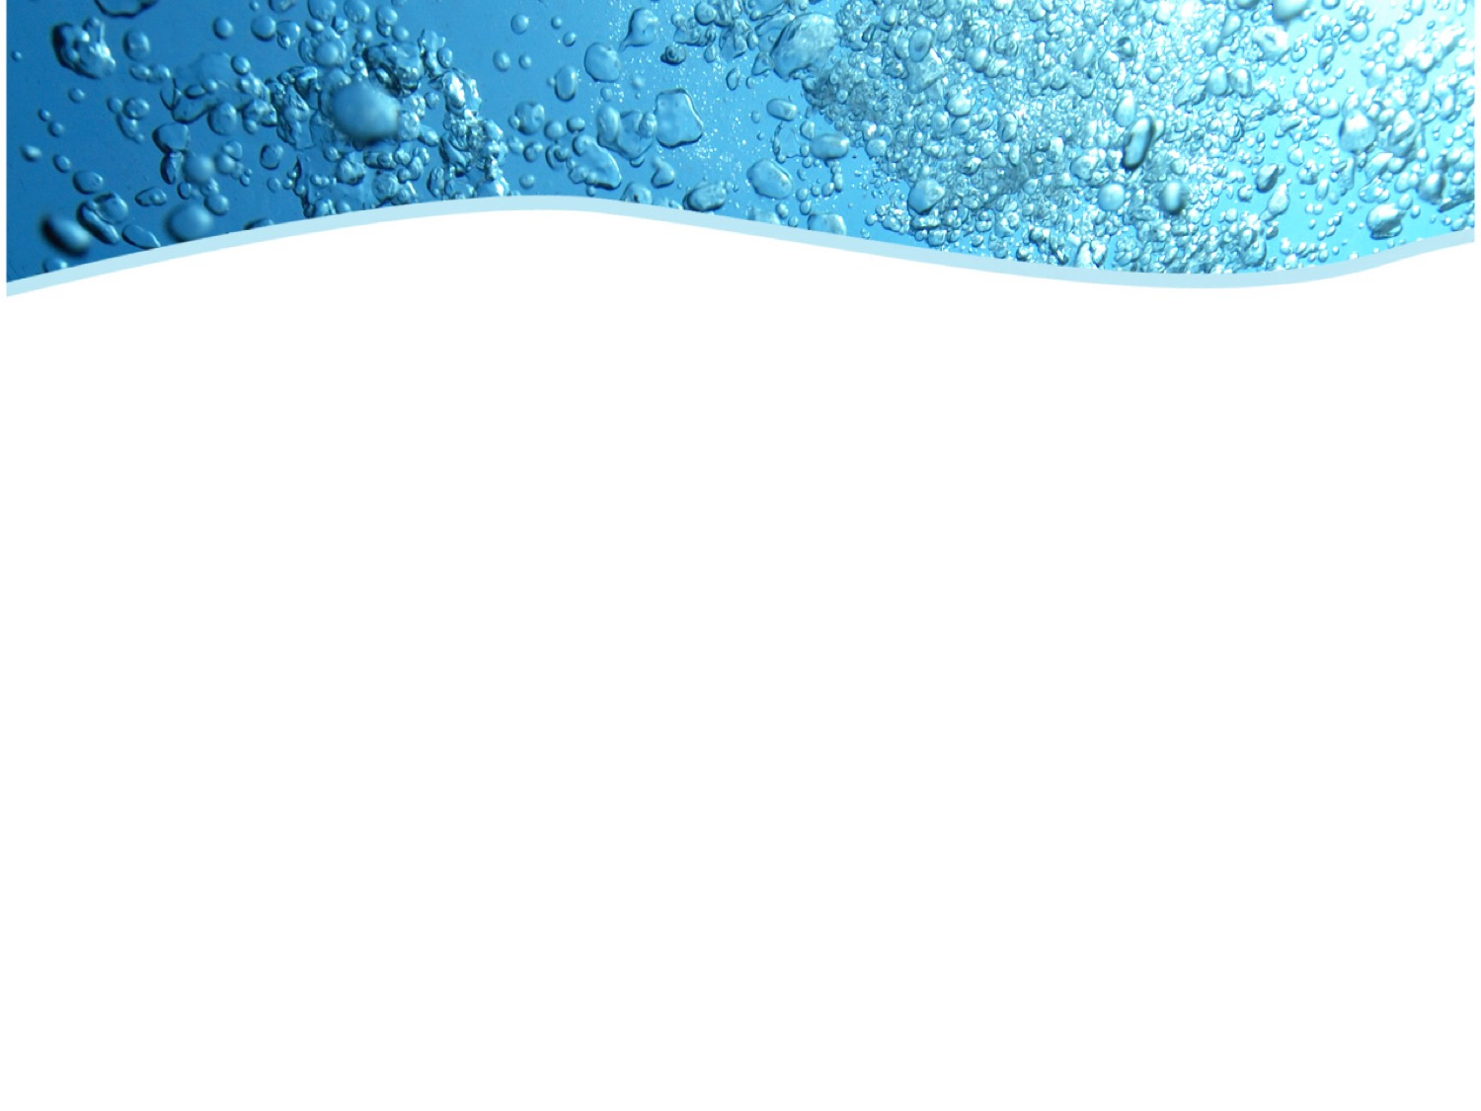
The importance of Fluids
All living things rely on internal fluids
Fluids are the solvents of our nutrients, gases, wastes, hormones… an overall delivery system
Terrestrial & Marine organisms struggle with fluid loss
Aquatic organisms struggle with fluid gain
Maintaining correct concentrations of internal fluids is vital to survival.

Slide 3
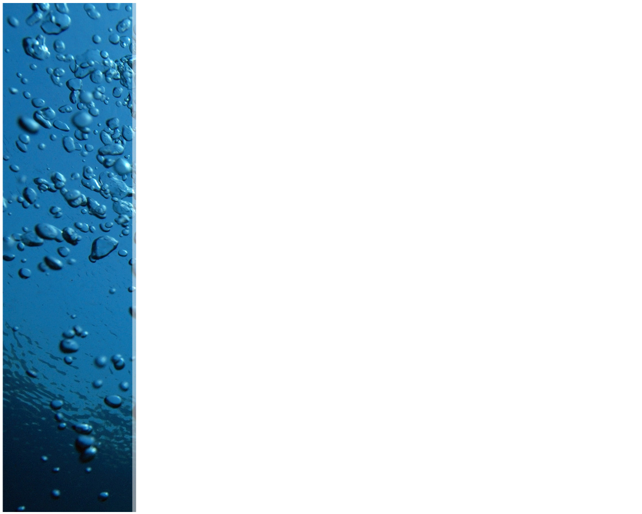
Fluid Homeostasis
In a vertebrate, three fluid types:
Intracellular Fluid (Cytoplasm)
Extracellular Fluid (ECF, interstitial fluid)
Blood Plasma (intravascular fluid)
All remain within similar concentration ranges and are separated by semipermeable membranes.
However, concentration fluctuates…

Slide 4
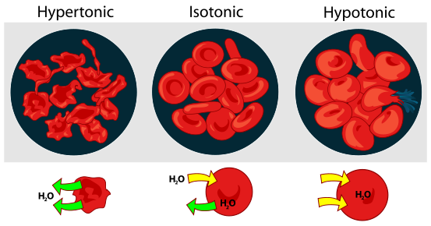
Osmotic Concentration
Dissolved solvents in a fluid affect its tonicity: hypertonic, hypotonic or isotonic solutions each have different effects:
Tends to dehydrate tissues
Ideal:
Fluid in = Fluid out
Tissues retain water;
Edema

Slide 5
Fluid Homeostasis
Depends on these organs:
Kidneys, as blood-filtering organs
Hypothalamus & Posterior pituitary
And also on these hormones:
Antidiuretic Hormone (ADH) from Hypo
(ADH is also called Vasopressin)
Aldosterone from the Adrenal Cortex
Angiotensin & Renin in the Kidney

Slide 6
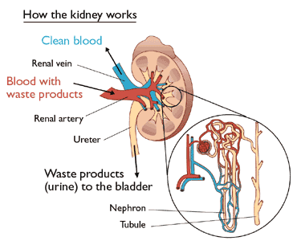
The Mammalian Kidney
Three layers:
  Cortex
  Medulla
  Pelvis
Pressure filtration
Selective reabsorption
Plasma is cleared of wastes; Urine forms.

Slide 7
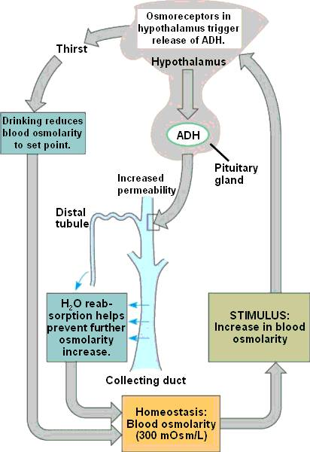
Action of ADH
Antidiuretic = prevents diuresis (water loss)
ADH is our water-saving hormone.

Slide 8
Action of ADH
Vasopressin = stimulates vasoconstriction & increases blood pressure.
With ADH: Maximum H₂O reabsorption back into blood; this saves fluid & creates a low volume of urine.
Without ADH: Minimal H₂O reabsorption back into blood; this releases fluid & creates a high volume of urine.

Slide 9
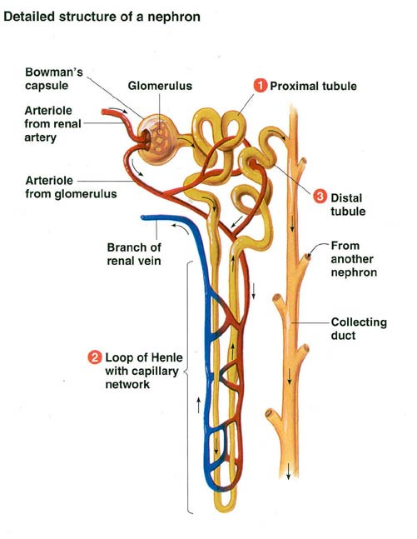
The Nephron
Four parts:
Glomerulus (force filter)
Proximal Convoluted Tubule (first reabsorption)
Loop of Henle (concentrates the urine by secretion)
Distal Convoluted Tubule (final adjustment of concentration by reabsorption)
All surrounded by capillaries

Slide 10
The Nephron

Slide 11

Urine & Your purse:
When a girl cleans her purse:
Everything gets dumped out
Things get sorted: valuables & useful things are put back, the trash is dumped.
When a kidney makes urine:
All the plasma gets dumped out into a nephron
Useful stuff is reabsorbed, waste isn’t; it is excreted as urine.

Slide 12
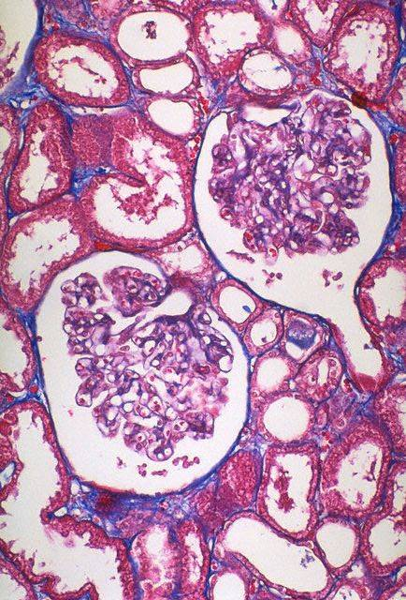
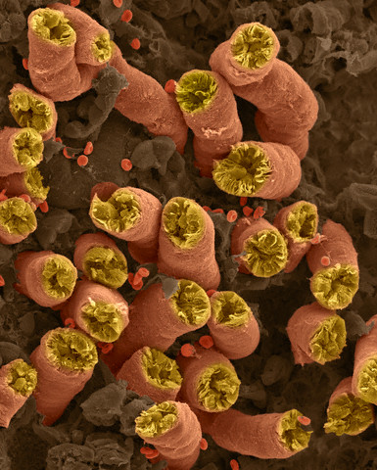
The Nephron up close

Slide 13
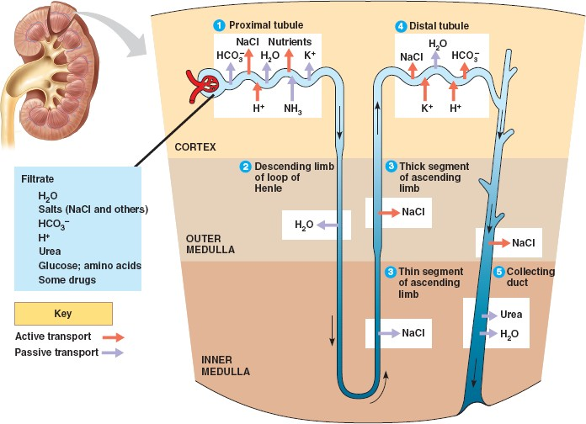
The Nephron at work
Each section has a specific job:

Slide 14
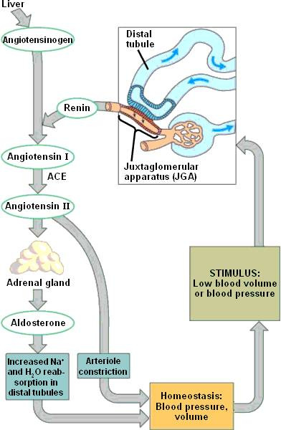
Aldosterone
Aldosterone = a steroid hormone; mineralocorticoid
Saves Sodium ions (Na⁺⁾ & Water.
Works with Renin & Angiotensin hormones, in a cascade system.

Slide 15
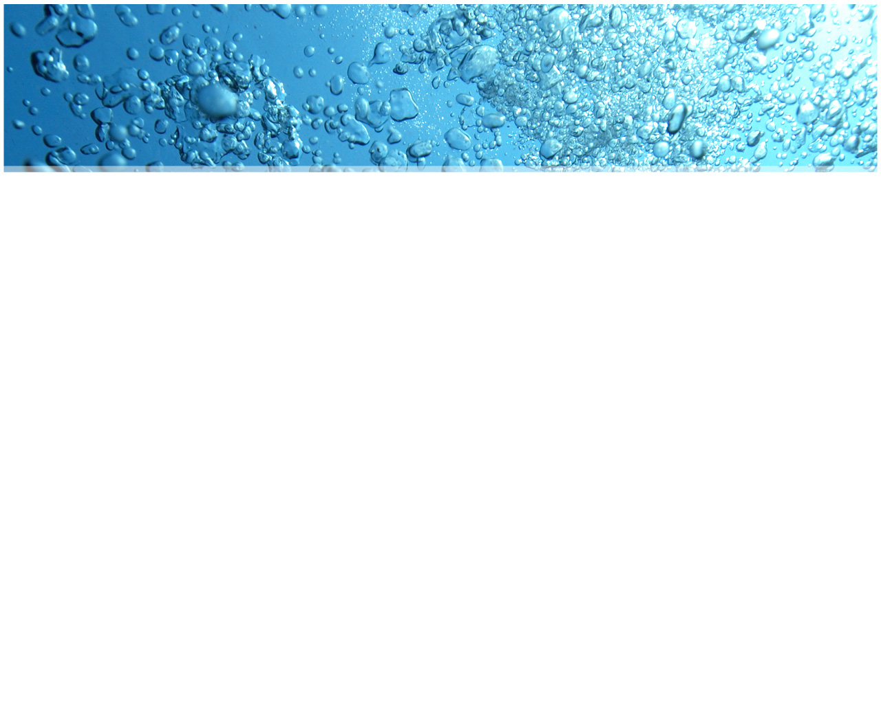
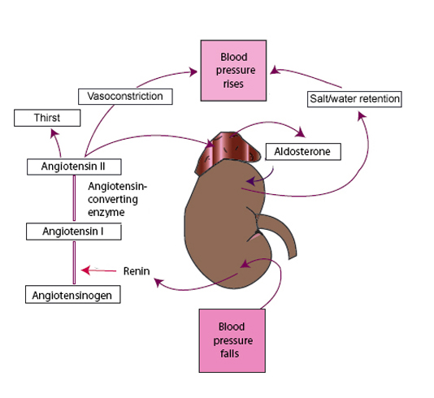
Renin-Angiotensin-Aldosterone Cascade

Slide 16
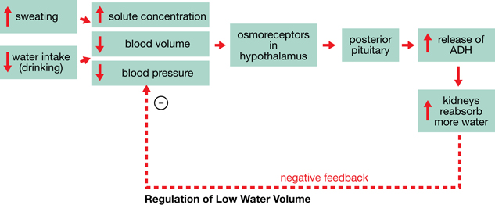

Slide 17
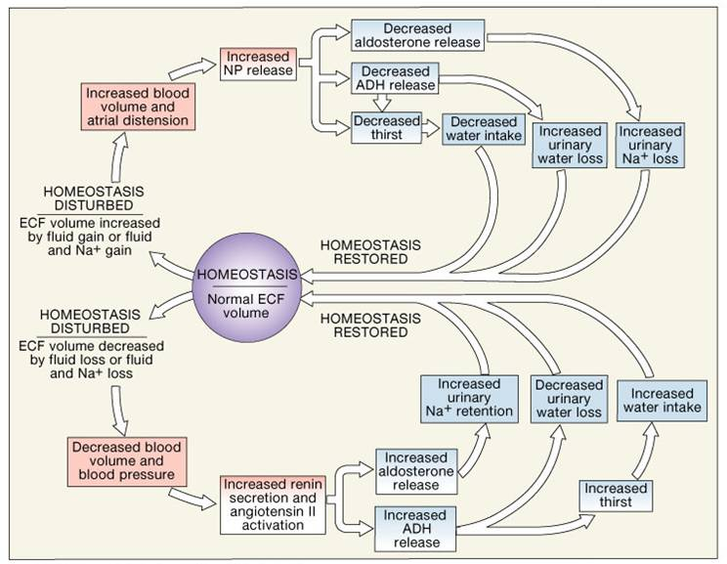

Slide 18
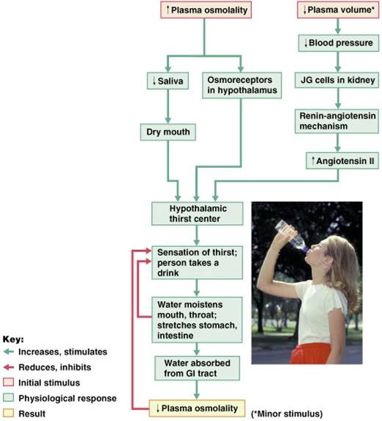
Fluid Homeostasis has to manage both water and ions.
The stimuli are changes in blood concentration and in blood volume.
Two parallel systems exist.

Slide 19
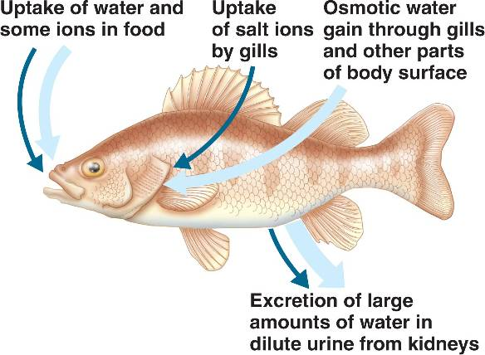
Other Homeostases:
Freshwater fish: living in a hypotonic environment, the threat is not water loss, but constant ‘dilution’.

Slide 20
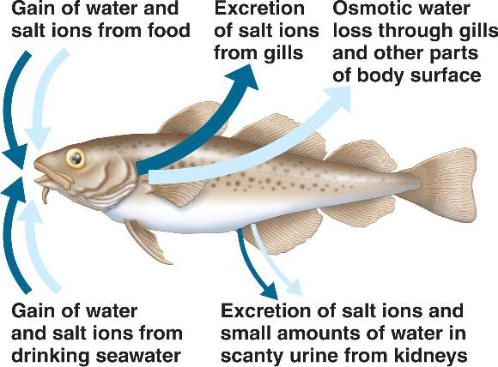
Other Homeostases:
Saltwater fish: living in a hypertonic environment, the threat is actually dehydration, due to Na⁺, K⁺ ions

Slide 21
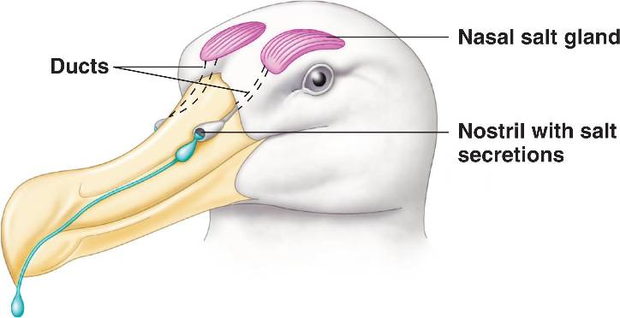
Other Homeostases:
Marine Birds & Sharks: salt-excreting glands.

Slide 22
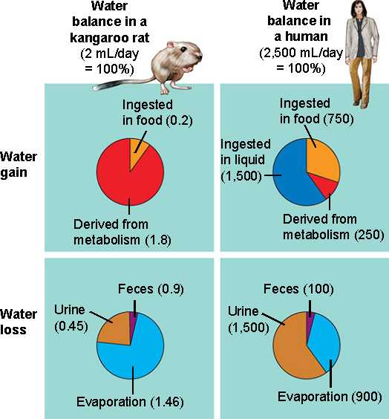
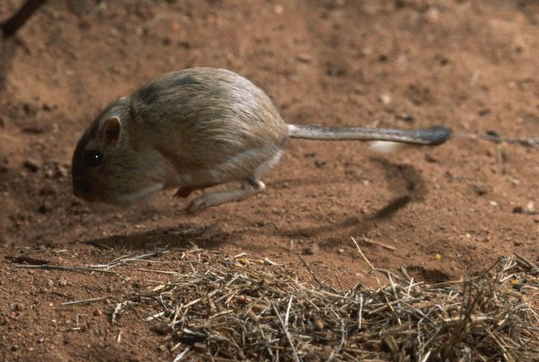
Other Homeostases:
Desert Animals: lack of water? No problem. The Jerboa, or Kangaroo rat, simply does not drink. It has incredibly long nephrons, too.

