Slide 1
Photosynthesis versus
Cellular Respiration
A simple comparison

Slide 2
The Background: Plants & Animals
Photoautotrophs
“self-feeding using light”
More ancient metabolism?
Only organisms able to trap sun’s energy.
Heterotrophs
“feeding from others”
Metabolism of multicellular life
Energy transfer

Slide 3
The Mitochondrion
Double membrane
Internal cristae & matrix
All multicellular organisms, including plant tissues.
Symbiotic origins: chemoautotrophic bacteria engulfed by larger heterotrophic cell, and surviving?

Slide 4
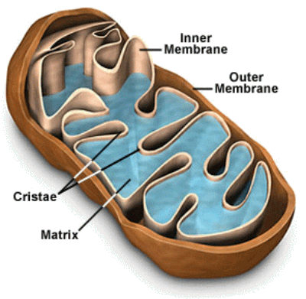
The Mitochondrion
Structure

Slide 5
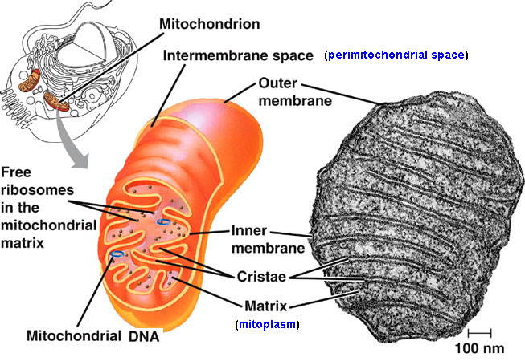
The Mitochondrion
Notes:
5

Slide 6
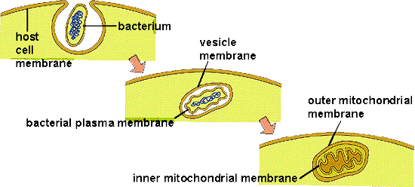
The Mitochondrion
Endosymbiotic origins: Evidence for this includes mitochondrial size, lack of organelles, & residual DNA. Some dispute this, based on the cristae’s resemblance to E.R. & Golgi Body
Notes:
6

Slide 7
The Chloroplast
Double membrane
Internal stroma & thylakoids, grana,
In most, but not all, plant tissues
Photosynthetic organ = the leaf
Symbiotic origins: engulfed by larger heterotroph, but survived?

Slide 8
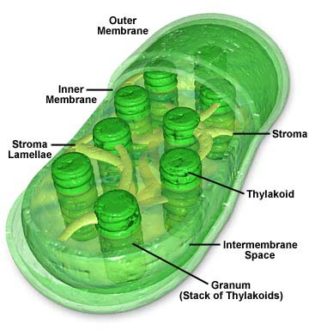
The Chloroplast
Structure:

Slide 9
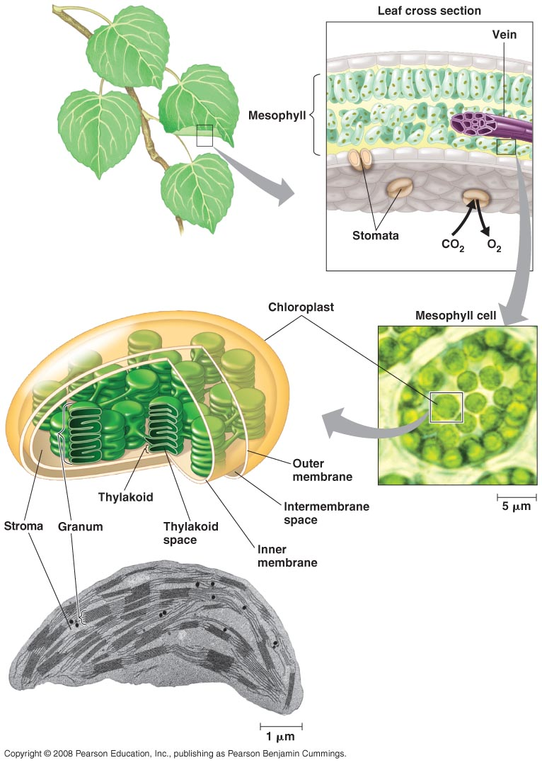
The Chloroplast
Notes:
9

Slide 10
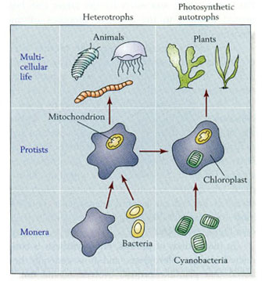
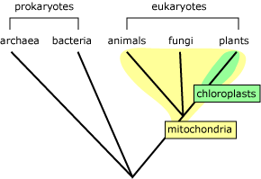
Comparison of Origins
Notes:
10

Slide 11
The chemicals involved
Mitochondrion contains numerous enzymes
Cytochrome proteins arranged in Electron Transport Chains
Coenzymes A, Q
NADH, FADH2
Chloroplast contains chlorophyll
Accessory pigments arranged in Photosystems
Coenzymes A, Q
NADPH

Slide 12
The processes involved
Cell Respiration = 3 phase process
Glycolysis in cytoplasm, rest in mitochondrion
Krebs’ in Matrix
Ox.Phos. on cristae
Makes H₂O
Photosynthesis = 2 phase process
Entirely in Chloroplast
Light Dependent Reactions on thylakoids
Light Independent Reactions in stroma
Needs H₂O
Notes:
12

Slide 13
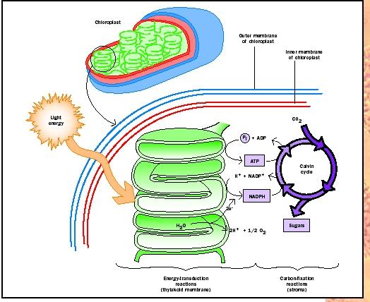
Photosynthesis Overview

Slide 14
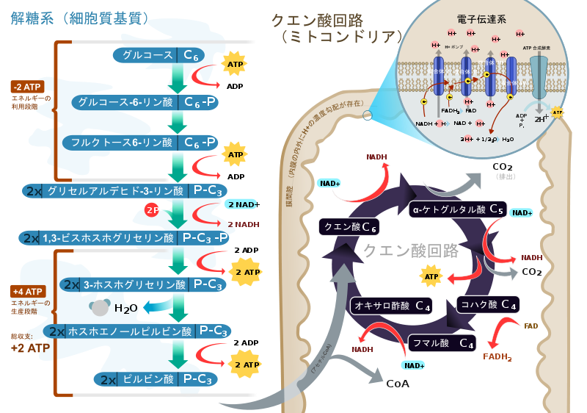
Cell Respiration Overview
Notes:
14

Slide 15
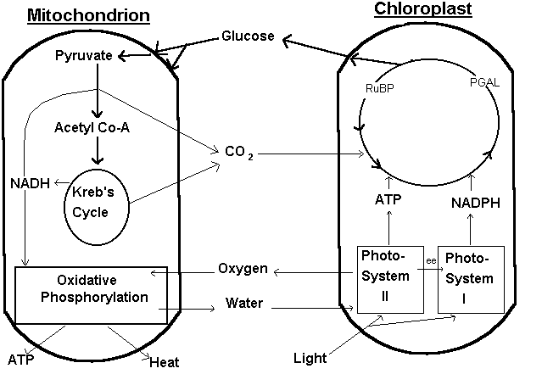
The processes compared
Notes:
15

Slide 16
Two Misconceptions:
Plants only need CO₂, not O₂
(they need both!)
Only animal cells have mitochondria
(all eukaryotic cells have them!)

Slide 17
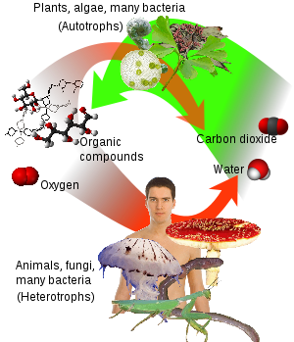
Unity of all living things!

